Slide 1







DA28 Capstone Project
My Project Steps:
  I researched my topic
  found credible information
  compiled my datasets
  cleaned the data
  wrangled the data
  explored my findings
  created visual modeling
I used the following tools:
  Jupyter Notebooks
  Python
  Pandas
  Microsoft Excel
  Matplotlib
  Seaborn
  Power BI
  Resources
https://www.dfas.mil
https://www.kaggle.com
https://www.navycs.com/charts/
https://fred.stlouisfed.org
https://www.census.gov
https://data.worldbank.org
https://diversity.defense.gov
https://sgp.fas.org
https://www.weforum.org
  I chose the topic for my project because I have been a military wife for almost 15 years.
Notes:
Hi. My name is Amber Harris and this is my Data Analysis captsone project.
Click - In my project I …
Click – I used…
Click – i chose…

Slide 2


Is our military allowing its members to live the
American Dream?
By, Amber Harris
Data Analyst
Notes:
This leads to my main question …

Slide 3
The American Dream
A steady income to support your family
Own your own home
Able to have security for the future
These allow you to have the freedom to do things, besides work, to make a fuller, happier life for yourself.
I’ve decided to equate living the American dream to
being a middle class citizen.
Notes:
The American dream is defined as…
Click - For this project, I have decided…

Slide 4
Background information
In 1973, military enrollment became voluntary
Military pay is comprised of:
  basic pay
  basic allowance for housing (BAH)
  basic allowance for sustenance (BAS)
All pay for this project is based on a 3 dependent household (a spouse and 2 children)
Notes:
Before we get into the nitty gritty numbers there is some background information that you need to know.
Click – ‘read’ That means that the members want to be there. This is the career they have chosen, and they have a passion for their jobs.
Click – military pay is different than civilian pay. It is comprised of 3 different categories:
Click - basic pay
This is calculated by the Employment Cost Index which measures private sector wages
This must be approved and voted on each year by Congress and can be overridden
Click - basic allowance for housing (BAH)
This is calculated based on location and dependents
This is a fairly recent change. Before 2017 it was a one size fits all price. You will see the effects of this change later on.
also work noting - If you live on base, you do not receive BAH.
Click – the last attribute is basic allowance for sustenance (BAS)
This is a flat rate calculated by the USDA food cost index and it is only enough to feed the military member. It doesn’t include their dependents
Click – ‘read’

Slide 5
Question #1:
Has basic pay kept up with inflation?
Notes:
My first question is…
This is important to know if wages have increased with or above inflation to know how well the military member can keep up with society.

Slide 6

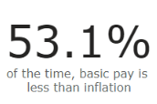
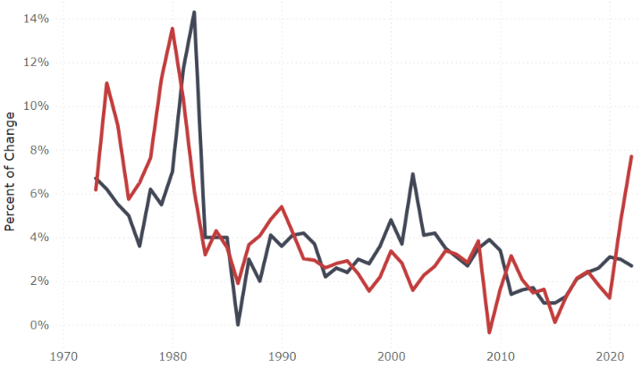
Has basic pay kept up with inflation?
Notes:
This data shows that 53.1% of the time basic pay raises have been less than inflation rates. This is the amount voted on by congress. Inflation generally peaks before pay does. As in the 1980’s, military pay took 2 years to catch up with it. They have tried at other times to catch up, but it definitely squeezes the military member’s wallets when it lags behind.
Even though the government has approved these pay increases, that is only for the basic pay, so the BAH and BAS frequently change at different rates which changes their overall raise.

Slide 7
Question #2:
How do I find the median military pay?
Notes:
The military has 1.4M members. There are 24 different pay grades based on education and training, and 9 steps for each pay grade based on time in service. I’ve decided to find the median pay for 2 different categories, enlisted and officer.

Slide 8
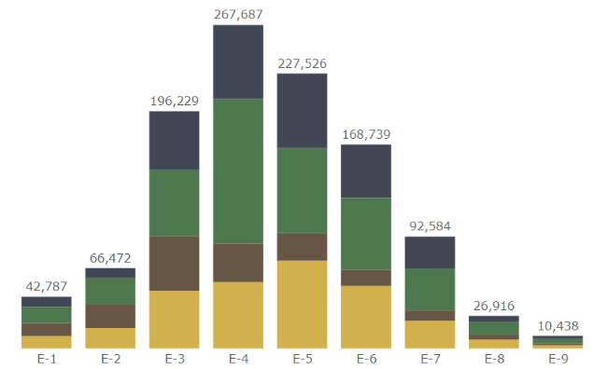


Active Duty Enlisted Personnel
*Must have a high school diploma
Enlisted Pay Grade
Notes:
82% of the military are enlisted.
Click- An enlisted military member must have a high school diploma.
Click - For my findings, I have chosen to use the median of an E4 pay grade. These members have been in the military for a minimum of 26 months. They have done training to specialize in their field. They are a team leads. In order to be qualified for a team lead they have to be the best at their current job.

Slide 9

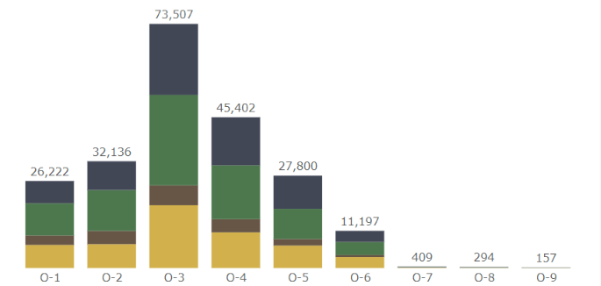

Active Duty Officer Personnel
*Must have 4+ yr College Degree
Officer Pay Grade
Notes:
Officers only make up 18% of the military. That is less than 250,000 people.
Click - They must have a college degree.
Click - For my findings, I have chosen to use a median O3 pay grade. Members are only eligible to be an O3 once they have their college degree and at least 3 years in the military. They command and control company-sized units of 62-190 members. They can also be instructors at schools and training centers.

Slide 10

Question #3:
How do military and civilian incomes compare?
Notes:
So, now that we have the median military data points ‘ read’

Slide 11
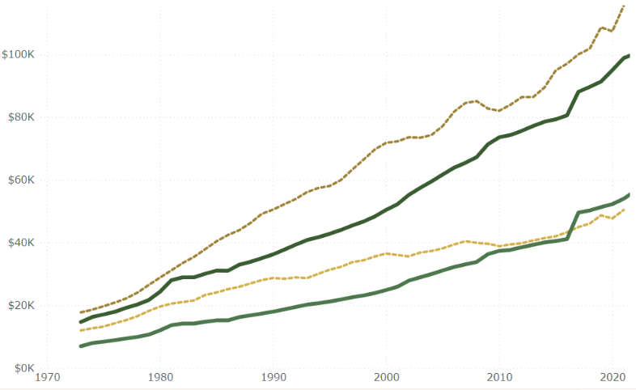
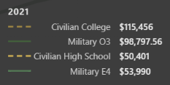
How do median military and civilian incomes compare?
These jumps are when the BAH changed from a flat rate to a rate based on location
Notes:
As you can see from this graph, military pay has always been below civilian pay for the same education level.
In 2017 the E4 military pay jumped above the civilian pay for the first time in history. This is because of the change in BAH that I spoke of earlier. In 2016 the military was receiving $799 for their housing allowance. Once it changed to location based it almost doubled for a lot of its members
In 2021 military officer pay still lagged behind civilians by almost 17k. And military enlisted pay was just over 3k more for a specialized job as a team lead.

Slide 12

Question #4:
Does deployment increase military wages?
Be good while I’m gone!
Notes:
Now, one would question if their wages could dramatically change by a deployment.

Slide 13
Does deployment increase military wages?
Deployments:
  Most are mandatory
  Usually between 3-18 months
  Most do not include taking your family
  Working hours drastically increase (60-80hr/wk)
  No matter the pay grade or rank the pay increase is the same:
    $250/mo family separation
    $225/mo hostile fire(if applicable)
  That is equivalent to $15.83 per day
Notes:
In order to answer that, there are a few things you need to know about deployments
Click –’read’
Click – ‘read’
Click – ‘read’ so you still have to keep your living arrangements the same. There is no saving money by living on base.
Click – ‘read’ – you get a so called “day off” to prepare your work for the next week (maintenance, reports, etc.) and a day off to get yourself ready (laundry, rest, etc.) and you definitely aren’t just working 8 hrs per day.
Click – now, ‘read’ for all military members.
Click – ‘read’
Is that incentive enough for you to work overtime, be shot at, and be away from your family while they struggle to keep up with the dual parent life that you created together.
That is not even enough for your spouse to hire a babysitter while you are gone.
So no, deployment does not make much of a difference in military wages.

Slide 14
Question #5:
Are military members able to be categorized as middle class?
Notes:
Ok..the big question ‘read’
Are they able to live the american dream that they are working so hard to defend?

Slide 15
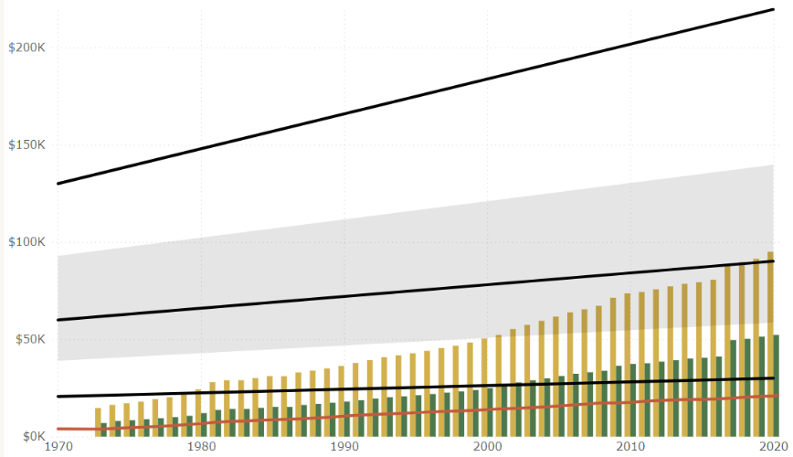

Are military able to be categorized as middle class?
$ 220K
Upper Class
$ 90K
Middle Class
Lower Class
$ 30K
$ 21K
Poverty Threshold
Notes:
Enlisted personnel never make it to middle class. They used to be so much lower than middle class that it seems like the government was just keeping them shy of being able to receive welfare.
In 2021, 57% of the lower class is comprised of individuals who never graduated from high school.
And only in the past 20 years have military officers been able to attain this status.
So an E4 with 3 dependents who has worked their entire career in the miitary and is a team lead in their industry still isn’t making enough to be
categorized as a middle class citizen.

Slide 16
Conclusion:
Unfortunately, the majority of military members are NOT able to live the American dream
Notes:
Officers in the military can make it to the American dream, but the majority of military members are not able to attain the American dream on their own.
Based on pay alone they will be able to provide for the basic needs of their family, but will struggle to save enough for a home or for retirement.
It is worth noting that only 17% of the military qualify for a full retirement which still is only 2.5% of their annual income

Slide 17


Slide 18
Resources
https://www.dfas.mil/militarymembers/payentitlements/Pay-Tables/PayTableArchives/
https://www.kaggle.com/datasets/rugbyrne/us-military-pay-scales
https://www.navycs.com/charts/
https://fred.stlouisfed.org/series/MEHOINUSA672N
https://www.census.gov/data/tables/time-series/demo/income-poverty/historical-income-households.html
https://data.worldbank.org/indicator/FP.CPI.TOTL.ZG?name_desc=true&locations=US
https://diversity.defense.gov/LinkClick.aspx?fileticket=gxMVqhkaHh8%3D&portalid=51
https://sgp.fas.org/crs/natsec/IF10685.pdf
https://www.census.gov/data/tables/time-series/demo/income-poverty/historical-poverty-thresholds.html
https://www.weforum.org/agenda/2022/07/household-income-distribution-wealth-inequality-united-states/

